Slide 1
INHOUSE TRAINING PROJECT
Made By:- Satyam Shandilya (2K17/ME/208)
Dhwani Dhingra (2K19/BMBA/07)
http://www.free-powerpoint-templates-design.com

Slide 2
Content
01
What is Volatility
02
Stationarity
03
Time Series Models
04
Methodology
05
Result
06
Conclusion

Slide 3
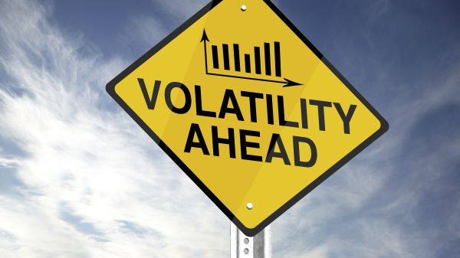
Volatility
Volatility is a statistical measure of the dispersion of returns for a given security or market index. In most cases, the higher the volatility, the riskier the security. Volatility is often measured as either the standard deviation or variance between returns from that same security or market index.
In the securities markets, volatility is often associated with big swings in either direction. For example, when the stock market rises and falls more than one percent over a sustained period of time, it is called a "volatile" market.
While variance captures the dispersion of returns around the mean of an asset in general, volatility is a measure of that variance bounded by a specific period of time. Thus, we can report daily volatility, weekly, monthly, or annualized volatility.

Slide 4
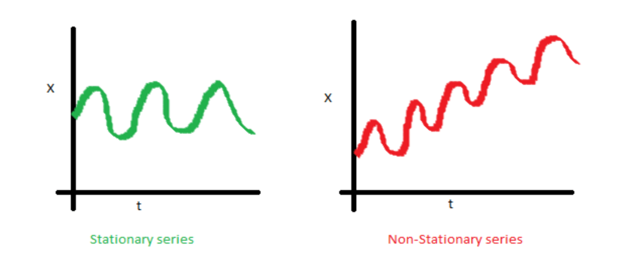
Stationarity
Consider a time series {rt } it is said to be strictly stationary if the joint distribution is invariant under time shift, this is very strong condition and is difficult to verify empirically, therefore a weaker version is often used in the time series analysis.
A time series is weakly stationary if the mean of the time series is constant and the covariance’s of rt and rt-l are time invariant where is an arbitrary integer.

Slide 5
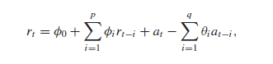
Time Series Models
1. Auto Regressive (AR) model:- Consider a weak stationary time series rt , if rt is correlated to rt-1 ,then rt-1 may be useful in predicting rt. We can make a simple model, Where at is white noise and Φ0 and Φ1 are constants. This model is simple AR(1) we can generalize this to AR(p) model.
2.Moving Average (MA) Model:- Consider a weak stationary time series rt , if rt is correlated to at-1 ,then at-1 may be useful in predicting rt. we can make a simple model, Where at is white noise. This model is simple MA(1) we can generalize this to MA(q) model. Where at is white noise and p is the lagged value. An MA model can be identified by looking into ACF plot.
3. Auto Regressive Moving Average (ARMA) Model:- This is just a combination of a AR and MA model this is used since using higher orders of above model become cumbersome and a simple ARMA(1,1) can be written as rt − φ1rt−1 = φ0 + at − θ1at−1, with this we can easily see it is a mixture of AR(1) and MA(1) model. An ARMA(p,q) can be written as:

Slide 6
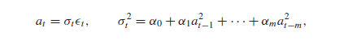
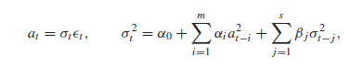
4. ARCH Model :-
It was introduced by Engel(1982) which provide a way to volatility modelling. The basic idea behind ARCH model is that (a) the shock at of an asset return is serially uncorrelated but dependent and (b) the dependence of at can be described by a simple quadratic function of its lagged values. A simple ARCH(m) model assumes:
Here εt is a IID(Independent and identically Distributed) sequence with a mean 0 and variance 1. α0>0 and αi>0 for i>0. From the structure of ARCH model we can say that large past squared shocks implies a large conditional variance σt² for the at, which means that, under the ARCH model, large shocks tend to be followed by another large shocks. This features are similar to the volatility clustering’s observed in an asset returns.
5. GARCH Model:-
This model is an extension ARCH model and is known as generalized Auto Regressive ConditionalHeteroscedasticity.
For a log return series r_{t} let a_{t} = r_{t}− μ_{t}be the innovation at time t, at follows a GARCH(m,s) model ,if
Here ε_{t} is independent and identically distributed with zero mean and a constant variance. Also α_{i} is 0 for i>m and β_{j} is zero for j>s. Also α_{i}+β_{i} implies that the unconditional Variance of at is finite but its conditional variance(σ_{t}²) evolves over time.

Slide 7
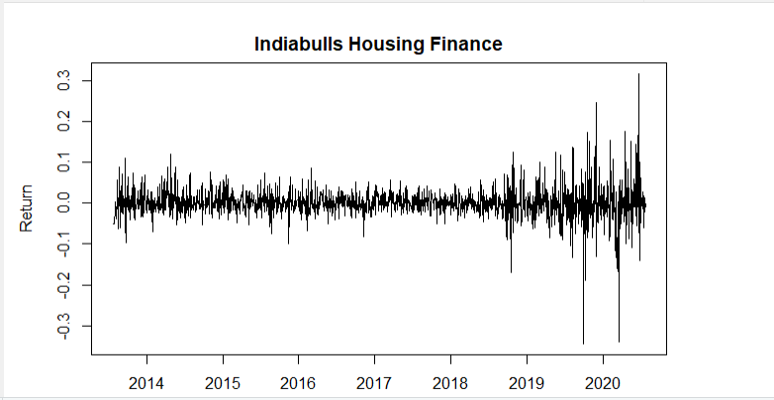
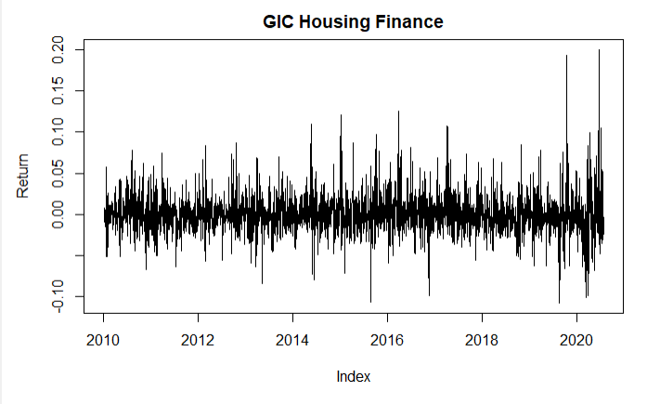
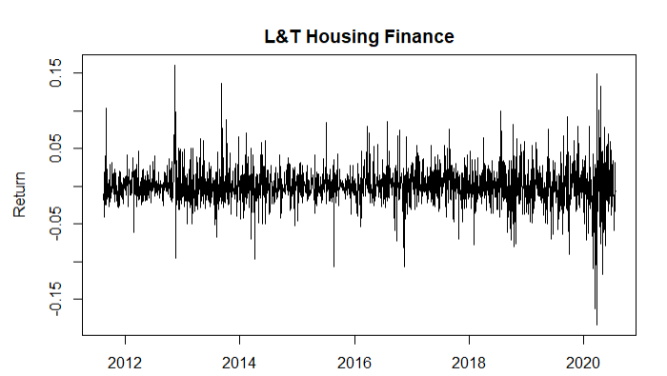
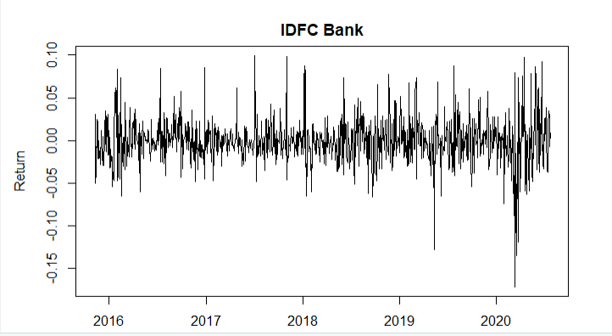
Methodology
The study is based on the data of daily stock prices downloaded from Bombay Stock Exchange covering a maximum sample size of past 10 years from 1st January 2010 to July 2020. We have considered the following four companies: 1) GIC Housing Finance Ltd., 2) IDFC First Bank Ltd, 3) Indiabulls Housing Finance Ltd, 4) Larsen & Toubro Limited.
In our study we have used the statistical methods to analyze the time series and study the volatility of these companies. To forecast the return of the financial time series we have used ARCH/GARCH model.
We can see in all the cases the return series is approximately centered around zero and on visual inspection volatility clustering seems to be there.
Graphs of return of different companies

Slide 8
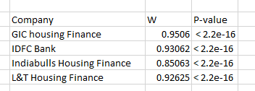
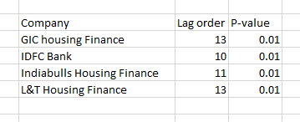
On running the shapiro-wilk test for normality it is confirmed that these series are not normal so these series appear to be follow a T-distribution curve.
Also by performing Augmented-Dickey Fuller Test we can say that all series are stationary

Slide 9
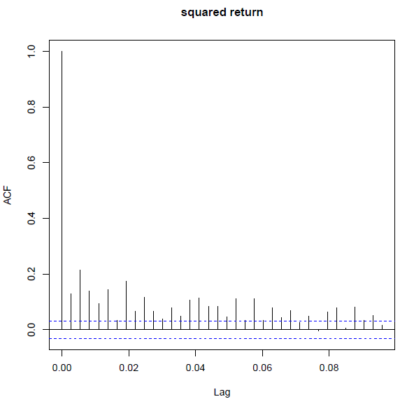
Let’s consider the L&T Housing Finance and proceed
Now let us look at some graphs:
By looking at following acf plot we can say there might be a need of AR(1) model and also by looking at absolute and squared return ACF plot we can say there might be an ARCH effect.

Slide 10
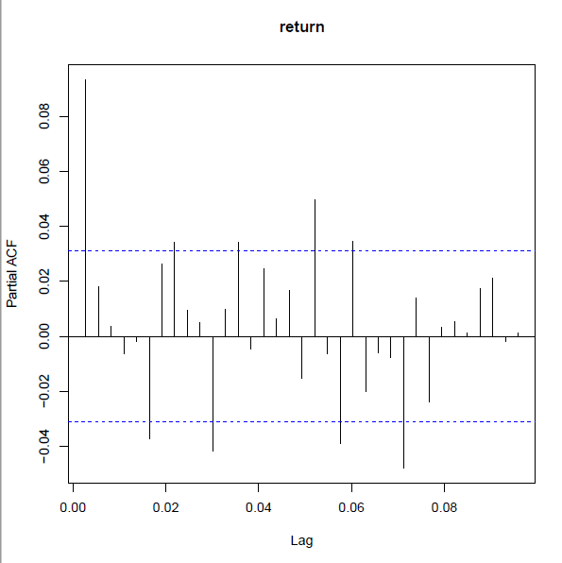
Through pacf plot of return we can say MA(1) model might be a good choice. Therefore we are
taking ARIMA(1,0,1)/ARMA(1,1).
After this we run an ARCH test (LM test) for which p-value was less than 0.05 hence this series is showing
ARCH effect.
In the following model’s we have taken mean model ARIMA(1,0,1)

Slide 11
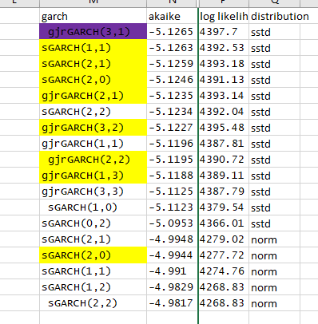
First we choose the sgarch with normal distribution since we have already shown the series is not normally distributed the results we got were bad and the goodness-of-fit was of order 10⁻¹³ or even lower.
Then we choose the SGARCH with t- distribution and then a EGARCH. In Egarch model The gamma was significant but since it was positive we rejected it.
And in the end we tried GJR-GARCH model with T-distribution.
Of all these model GJR-GARCH(3,1) has the lowest akaike value and a very decent goodness-of-fit.
After this we back-tested the model on the known dataset and we got a VAR value at excedances of 2.8% and the failures were independent.
Hence ARIMA(1,0,1)/GJR-GARCH(3,1) with a T-distribution model was our choice to predict future volatility.

Slide 12
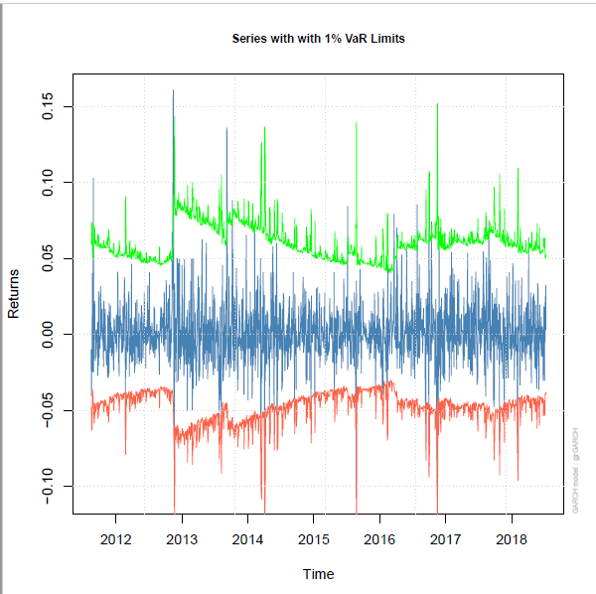
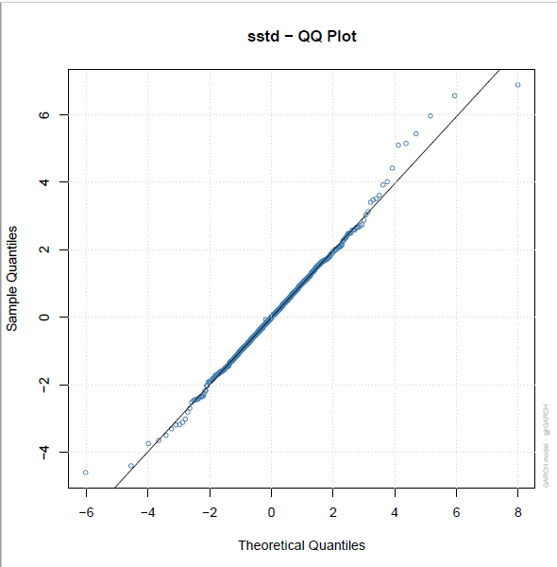
Result
This graph shows the series with 1% value-at-risk limits and most of our series is above 1% VAR limit
By looking at QQ plot we can tell that there is no correlation between the residuals.

Slide 13
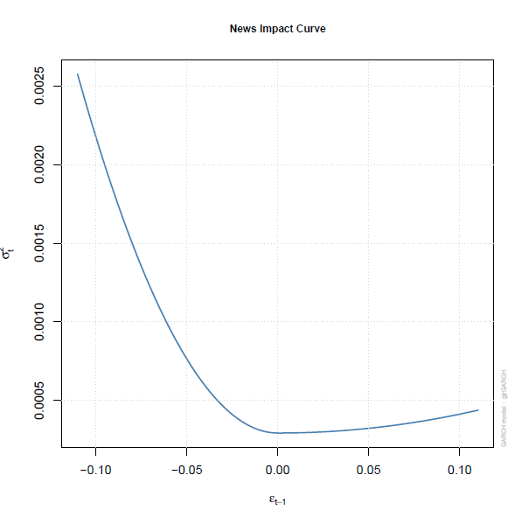
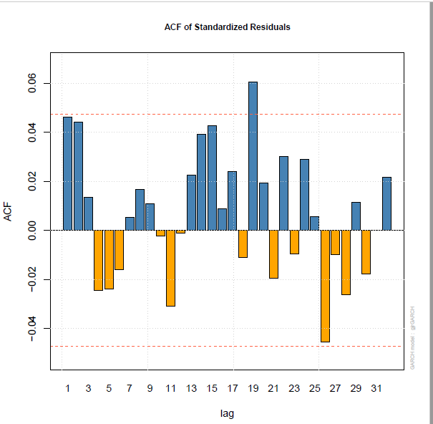
The acf plot of standardized residual also tells that there is no correlation.
The news impact curve of L&T shows that the impact of negative news is much greater than the impact of positive news on volatility..

Slide 14
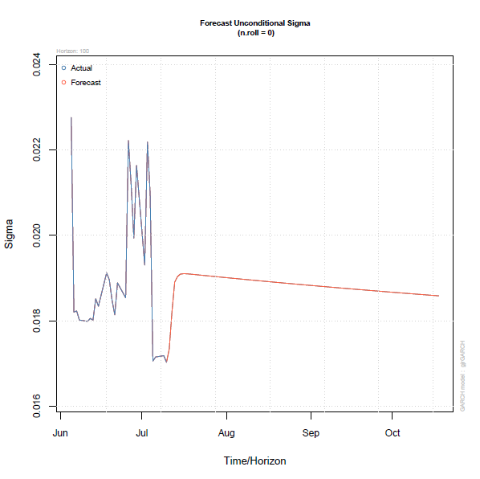
The forecast of L&T shows that the volatility is going to decrease after mid-July.

Slide 15
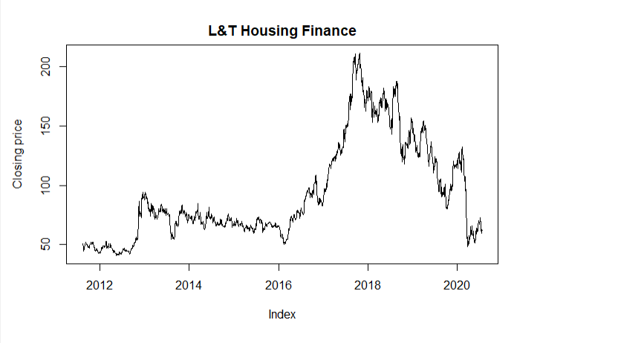
Conclusion.
The closing prices of all the company saw a decline in 2016 and 2017 which is in a known fact due to Demonetization and GST implementation and after 2019 a slowdown is clearly visible.
Due to COVID-19 pandemic the decrease in Closing prices is also visible the volatility of the company increase suddenly due to the crisis as the Lockdown were imposed and closing prices fell. Till late April the volatility of the company was high as the prices fell and after that they were a little stable for some time there, then as the unlock process started and the economic activity started we can see an increase in the volatility due to the fact that the closing prices started increasing and the return also increased.
Our model has predicted that the volatility of the company will increase till mid-july for L&T Housing Finance and mid-August and then the volatility will appear to get stable after that.

Slide 16

Thank You

